Slide 1
Agile Processes
Dirk Riehle, Univ. Erlangen
AMOS B03
Licensed under CC BY 4.0 International

Slide 2
Agenda
Software development
Plan-driven development
Agile methods
Scrum

Slide 3
1. Software Development

Slide 4
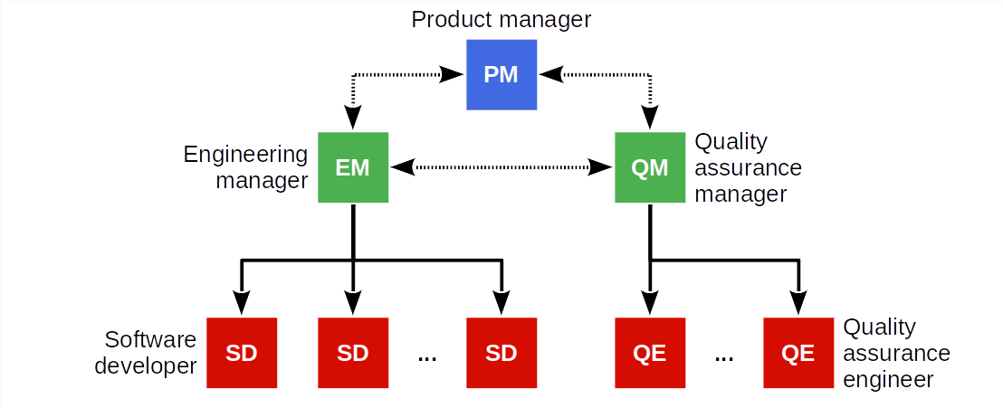
Typical Software Development Organization

Slide 5
Positions and Job Descriptions
Product manager / product management is responsible for
Managing a company’s products along its life-cycle across a portfolio
Engineering manager / engineering management is responsible for
Managing the development of the products (along / across)
Software developer / software development is responsible for
Designing and implementing the products (along / across)
Quality assurance is responsible for
Ensuring that the quality of the products meets the expectations

Slide 6
What / Who / How?
Product managers are responsible for
What needs doing
Engineering managers are responsible for
Who gets to do it and when
Software developers are responsible for
How it gets done and how long it will take

Slide 7
Products vs. Projects
Products have a life-cycle; may live forever
Products are developed for a market (many customers)
Projects have a defined start and end date
Projects are developed for one client (one customer)
Project terms, roles, and positions often differs from product terms
Product manager → business analyst, requirements engineering
Engineering manager → project manager

Slide 8
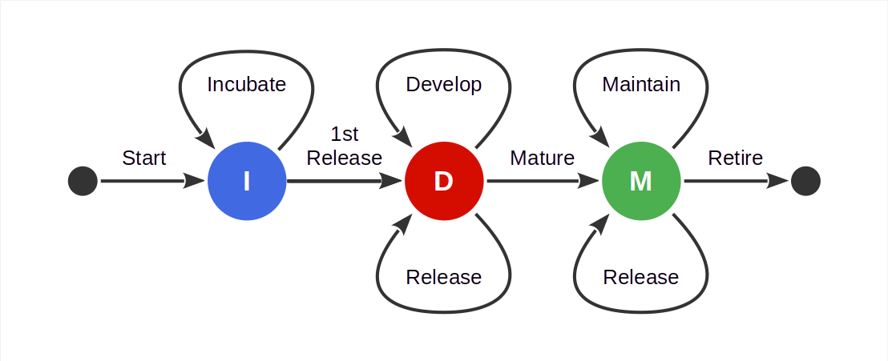
Basic Software Product Life-Cycle

Slide 9

The Magic Triangle (“Pick Two”)

Slide 10
2. Plan-Driven Development

Slide 11
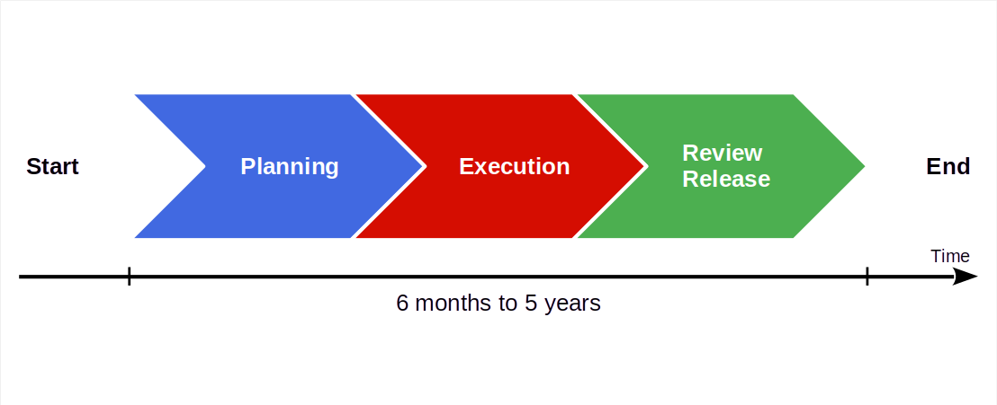
Basic Plan-Driven Development

Slide 12

Video From “The Pentagon Wars” [1]
[1] See https://youtu.be/r0op8e0LuoU

Slide 13
Video Lessons
Stakeholders problems
Multiple stakeholders with conflicting interests
Meddling stakeholders intervening into the process
Requirement problems
Inconsistent requirements (poor quality assurance)
Changing requirements (wandering focus, long project)
Feature creep (from troop carrier to tank)
Product problems
Cost explosion due to lack of focus, rework
Unclear market and wandering purpose

Slide 14
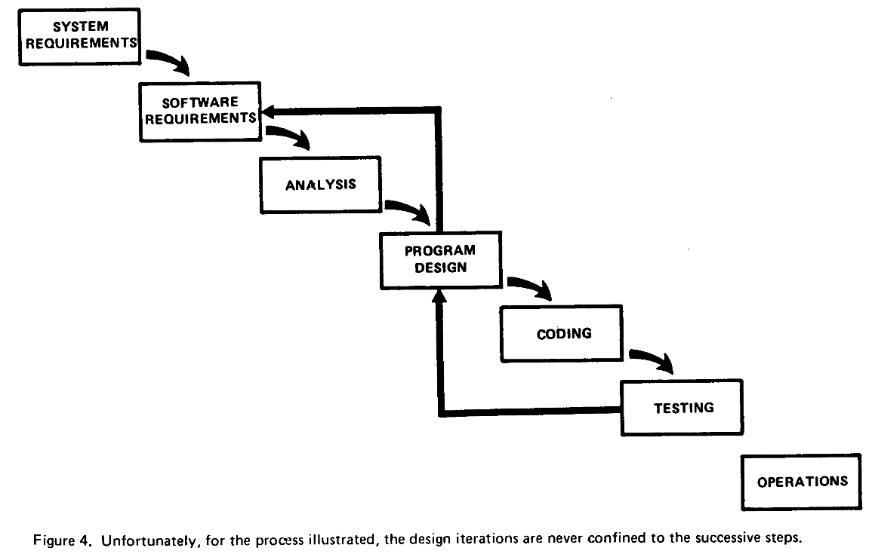
The Waterfall Model [1]
[1] Royce, W. W. (1970). Managing the development of large software systems. Proceedings of IEEE WESCON. Los Angeles, 328-388.

Slide 15
Main Lesson From Plan-Driven Development
Phases ≠ Activities

Slide 16
3. Agile Methods

Slide 17
Agile Methods
Agile methods are a category of software development methodologies
Defined in opposition to plan-driven development
Driven by consultants as a significant business opportunity
The key idea of agile methods is to have a fast feedback loop
Steer, don’t plan and blindly execute
Codified as the agile manifesto
Examples agile methodologies
Scrum, XP, the Crystal Methods, Feature Driven Development

Slide 18
Principles of the Agile Manifesto [1]
Individuals and interactions
Over processes and tools
Working software
Over comprehensive documentation
Customer collaboration
Over contract negotiation
Responding to change
Over following a plan
[1] See https://agilemanifesto.org

Slide 19
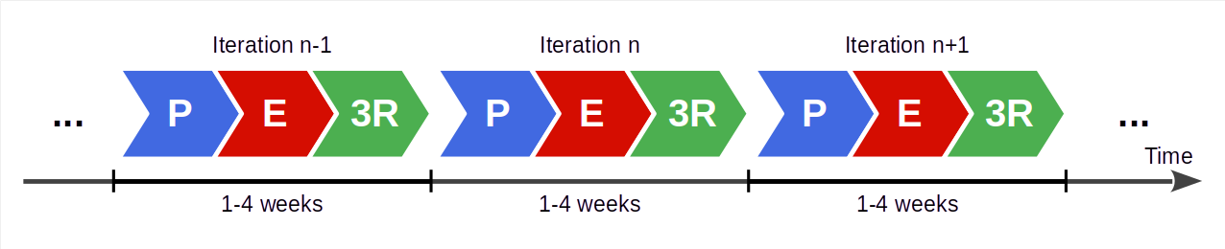
Agile Development Process
Succession of equal-length iterations (“time-boxes”, “sprints”)
Intervention points are during planning and review
User feedback only available during review
P = Planning
E = Execution
3R = Review, release, and retrospective

Slide 20
Benefits of Fast Feedback Loops
Short iterations
Short iterations lead to focus on high-value features first
Established well-worn rhythm is sustainable, avoids burnout
Partial functionality is better than none
User feedback
User feedback helps team steer product to meeting needs right
Feedback loop ensures that problems surface early
Feedback helps recognize and realize new innovative features

Slide 21
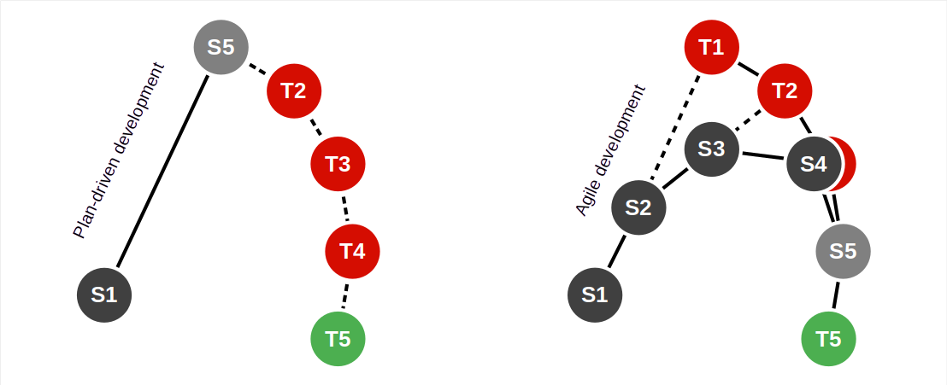
Plan-Driven vs. Agile Processes

Slide 22
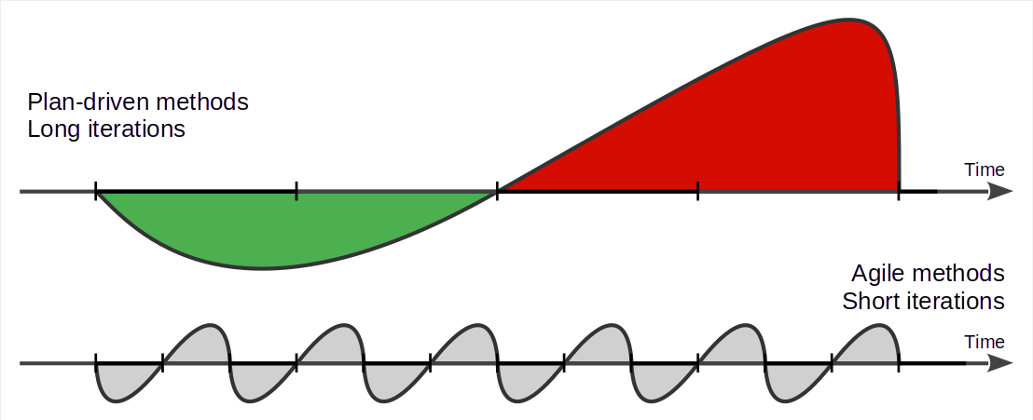
Plan-Driven vs. Agile Work Rhythms

Slide 23
Do Agile Methods Lead to Cowboy Coding?
Agile methods are high discipline

Slide 24
4. Scrum

Slide 25
Scrum [1]
Scrum is an agile method invented around 1993, 1995
Has a minimal (agile) process model
Is applicable to any domain, not just software development
[1] Schwaber, K., & Sutherland, J. (2020). The scrum guide. Web-published.

Slide 26
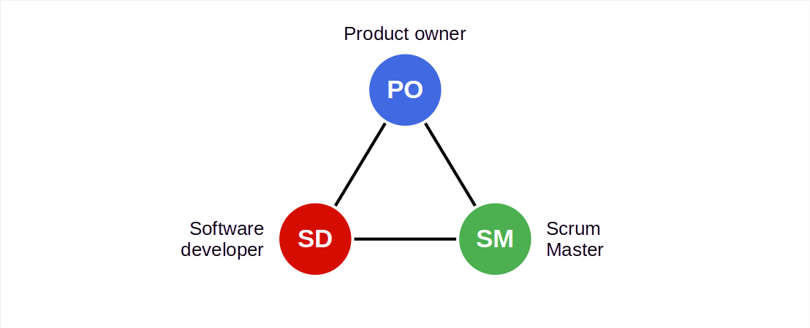
Scrum Roles

Slide 27
Committed vs. Involved Roles
Committed parties
Product owner
Software developer(s)
Scrum Master
Involved parties
Customer
Sponsor / funder
Regulators
…

Slide 28
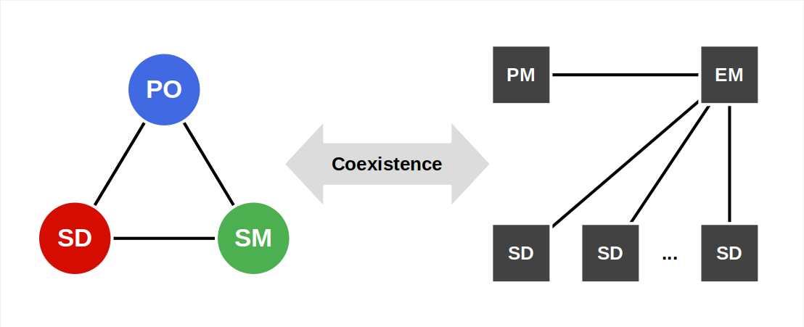
Mapping Roles to Posts

Slide 29
Roles / Posts Correspondence
Product management Engineering management | → | Product owner
Software development Engineering management Quality assurance | → | Software developer
Engineering management | → | Scrum Master

Slide 30
Terms (The Scrum Terminology Mess)
Scrum | Product development | Project implementation
Product owner | Product manager | Business analyst, Requirements engineer
Product goal | Product vision [1] | Project mission [1]
Product backlog | Product requirements documentation (PRD) | Requirements specification
[1] This resolution is specific to AMOS, though the terms are generally known and used

Slide 31
Scrum Scope
Scrum proper covers
Day
Sprint (weeks)
Project/product releases (months)
Further evolutions e.g. SAFe cover
Product life-cycle (years)
Portfolio

Slide 32
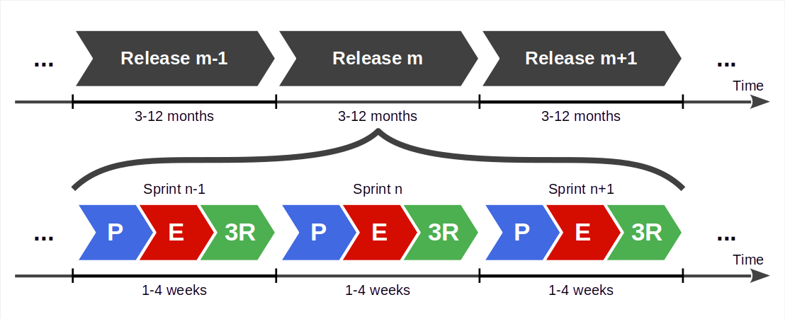
Scrum Process

Slide 33
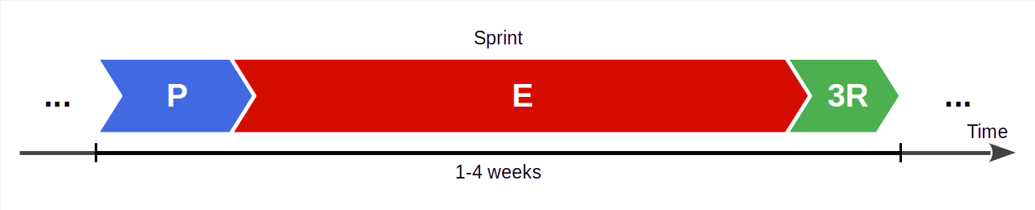
Scrum Sprint
A sprint is Scrum’s iteration; it is an equal-length time-box
It is a highly structured process with defined feedback points

Slide 34
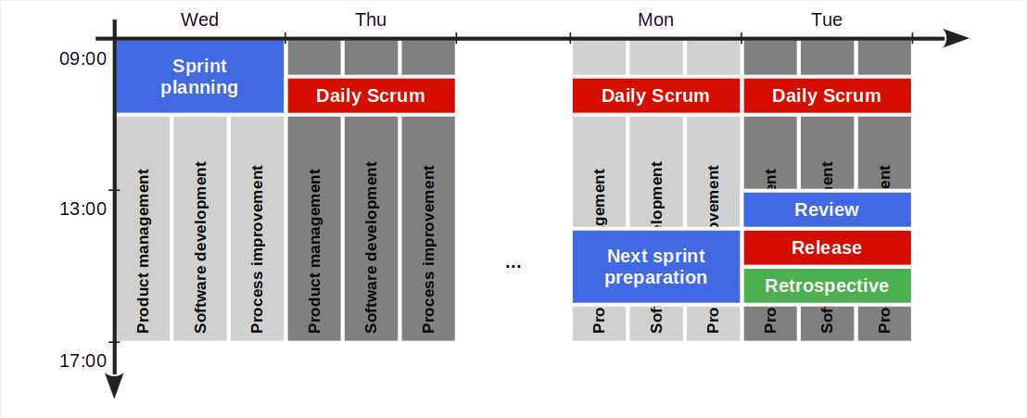
Sprint Structure

Slide 35
Sprint Meetings
The AMOS
team meeting
Next sprint preparation
Product owner and senior developer groom the product backlog
Sprint review
Team reviews this sprint’s results, signs off on them
Sprint release
Team decides on sprint release
Sprint retrospective
Team reviews process, commits to improvements
Sprint planning
Team discusses upcoming work, commits to it
Daily Scrum
Team members update each other on work progress

Slide 36
Sprint Workstreams
Product management; the product owner
Grooms the product backlog
Answers questions to developers
Software development; software developers
Break down backlog items into tasks, self-organize
Design and implement sprint backlog items
Process improvement; the Scrum Master
Observes problems and opportunities
Facilitates impediments resolution and improvements

Slide 37
Summary
Software development
Plan-driven development
Agile methods
Scrum

Slide 38
Thank you! Any questions?
dirk.riehle@fau.de – https://oss.cs.fau.de
dirk@riehle.org – https://dirkriehle.com – @dirkriehle

Slide 39
Legal Notices
License
Licensed under the CC BY 4.0 International license
Copyright
© Copyright 2023 Dirk Riehle, some rights reserved

